Slide 1
Ai-Based mental health recommender

Slide 2
Introduction
Mental health is just as important as physical health, but it can be difficult to know where to start when you're feeling down or stressed. That's where our AI recommender comes in.
Our recommender uses artificial intelligence to generate personalized recommendations for activities that can improve your mental well-being. Whether you're looking for music to listen to, books to read, or podcasts to listen to, our recommender has you covered.
We believe that everyone deserves to have access to the resources they need to improve their mental health. That's why our recommender is free to use for everyone.

Slide 3
Current problems
Accessibility: Many people struggle to access mental health services due to cost, location, or availability.
01
Personalization: Traditional mental health support often lacks personalization, which can make it less effective.
02
Stigma: There is still a significant stigma associated with seeking help for mental health issues, which can prevent people from getting the help they need. There is still some social awkwardness of talking about mental to other people
03

Slide 4
Novelty
Personalized Recommendations: The AI mental health recommender is designed to provide personalized activity recommendations based on the user’s preferences and mood. This level of personalization is a novel approach in mental health support.
AI and Machine Learning: The use of AI and Machine Learning for understanding the user’s current state and preferences is a unique aspect of this recommender. It allows the system to learn and improve over time, providing better and more accurate recommendations.
Activity Database: The recommender uses a database of activities that are curated and vetted by mental health professionals. This ensures that the recommended activities are beneficial for mental health, adding a layer of reliability and trust to the system. The activities include music, books, fitness activities , etc.

Slide 5
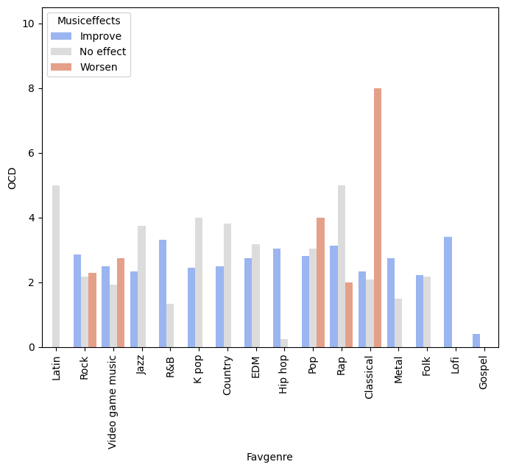
Methodologies
Our innovative Recommender system is designed to provide personalized music recommendations based on the user’s mental health status. The user’s input is crucial in this process, as it allows the system to understand their current mental health condition. This could range from various mental health disorders such as depression, anxiety, insomnia, or Obsessive-Compulsive Disorder (OCD).
Each of these mental health conditions requires a unique approach for management and our Recommender system acknowledges this diversity. Upon receiving the user’s input, the system initiates an in-depth analysis. It meticulously examines the information provided by the user, taking into account the nuances of their mental health status. This analysis is not a one-size-fits-all; it is a customized process, finely tuned to align with each user’s unique needs.
Based on this comprehensive analysis, the Recommender system then suggests music genres that would be most beneficial for the user.

Slide 6
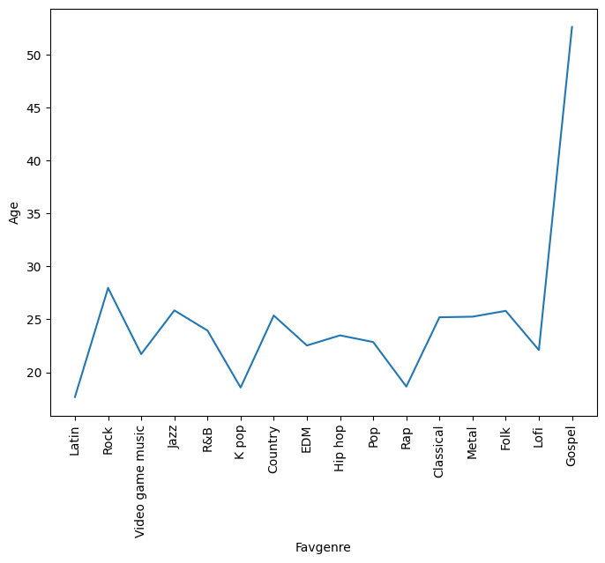
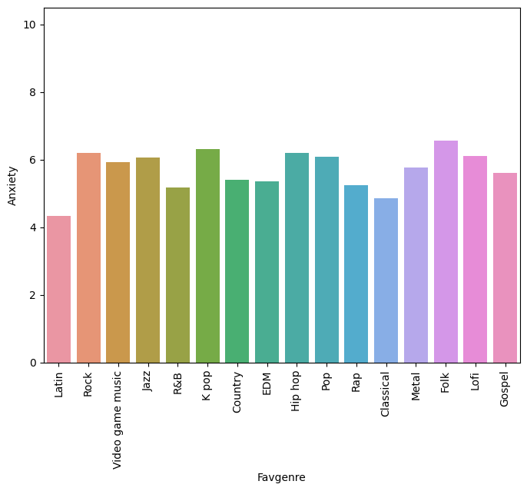
Factors

Slide 7
Future Aspects
User Input Analysis:
The system analyzes user inputs using Natural Language Processing (NLP) to understand their current state and preferences.
Keyword Extraction:
The system identifies key words or phrases from the user’s inputs that indicate their interests or mood.
Keyword Extraction:
The system identifies key words or phrases from the user’s inputs that indicate their interests or mood.

Slide 8
Useful Activities
Music Recommendations: The AI can recommend music based on the user’s preferences and current mood. For example, if the user is feeling stressed, the AI might recommend a calming classical music playlist.
Book Recommendations: The AI can recommend books that match the user’s interests and could potentially benefit their mental health. For example, if the user is interested in mindfulness, the AI might recommend a book on mindfulness techniques.
Fitness Activities: The AI can recommend fitness activities based on the user’s physical health goals and preferences. For example, if the user wants to increase their focus and reduce stress, the AI might recommend a yoga routine.

Slide 9
Social Impact
Increased access to mental health support: Recommender can make mental health support more accessible and affordable, especially for people in underserved communities.
Reduced stigma associated with mental health: It can help to reduce the stigma associated with mental health by making it easier for people to talk about their mental health and to seek support not through a human but a chatbot which would reduce social awkwardness.
Improved mental well-being: It can help people to improve their mental well-being by providing them with personalized recommendations for activities that can reduce stress, anxiety, and depression.
Increased self-awareness: It can help people to become more self-aware and to identify their mental health needs.
Empowerment: It can help people to feel more empowered to take control of their mental health.

Slide 10
The freemium model
Basic Services for Free:
Users can access basic features of the AI recommender for free. This could include a limited number of activity recommendations per day or week. The goal is to attract users to the platform and demonstrate the value it can provide.
Premium Services for a Fee:
More advanced features are available for a subscription fee. This could include unlimited activity recommendations, access to a wider range of activities, ability to save and track progress, and priority access to new features and updates.
Conversion of Free Users to Paid Users:
The aim is to convert free users to paid users over time. By experiencing the value of the free service, users may be inclined to pay for additional features that can enhance their experience and provide more personalized and comprehensive mental health support.

Slide 11
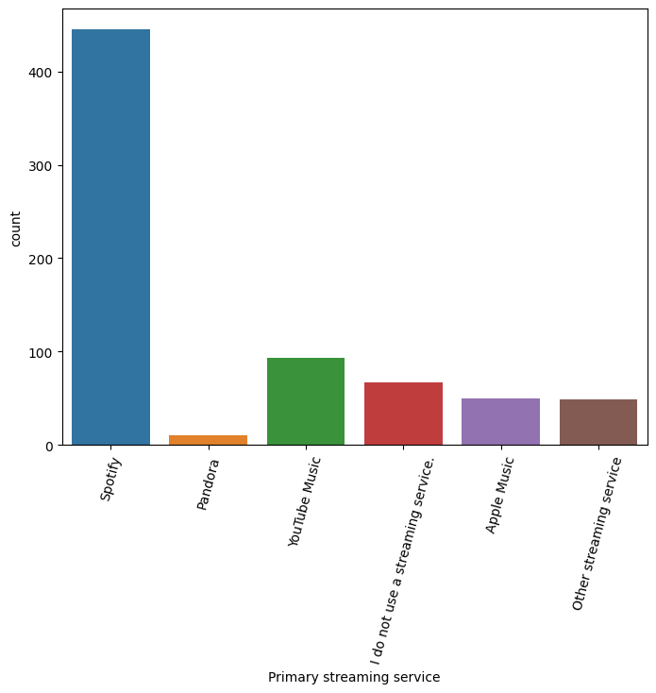
Partnerships

Slide 12
Additional Revenue sources
Advertisements for Mental Health Products:
By displaying advertisements for relevant mental health products, the platform can generate revenue from ad impressions and clicks. These could be products that aid in mental health management, such as self-help books, wellness apps, or therapeutic tools.
Partnerships with Hospitals and Doctors: Partnering with hospitals and doctors can provide a referral system. If the AI determines that a user’s condition is severe or not improving, it can recommend consultation with a partnered hospital or doctor. For each referral, the platform could earn a fee.
Partnerships with Music Services:
Collaborating with music services like Spotify can enhance the user experience and also generate revenue. When the AI recommends a song or playlist, it can direct the user to the song on the partnered platform. The platform could earn a commission for traffic or new subscriptions generated through these referrals.

Slide 13
SUMMARY
The AI mental health recommender is a novel solution that leverages AI and Machine Learning to provide personalized activity recommendations based on the user’s preferences and mood. The potential social impact of the recommender is significant, as it can help reduce stigma, improve societal well-being, and reach underserved populations.
This AI mental health recommender represents a significant advancement in the field of mental health support, combining technology and mental health expertise to provide personalized, accessible, and effective support.

Slide 14
THANK YOU

